Slide 1
Test metrics & measurements

Slide 2
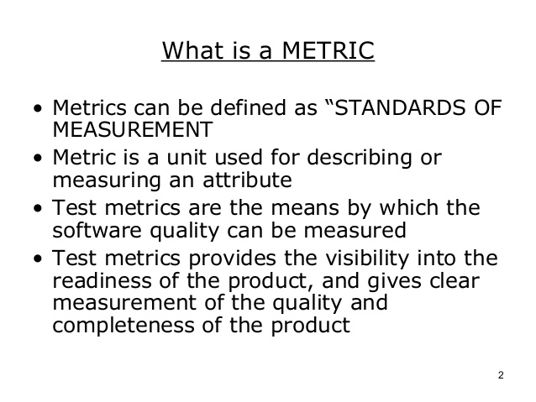

Slide 3
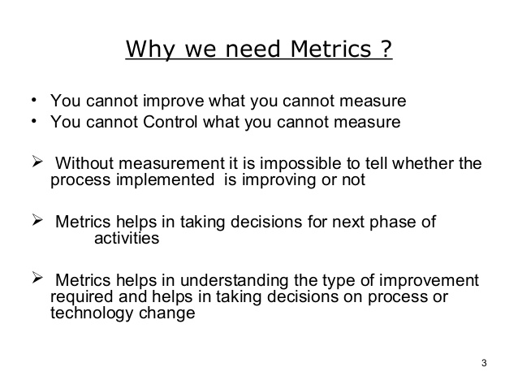

Slide 4
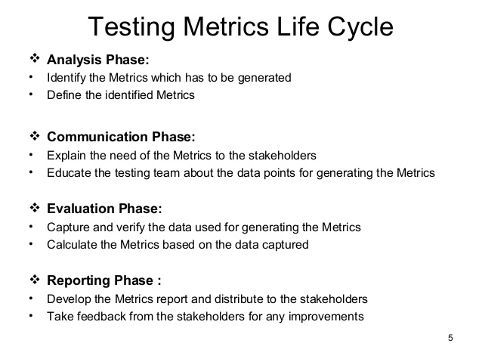

Slide 5
Metrics types
Metrics can be classified on the basis of what they measured and what area they are focused on
Classification of metrics –Product metrics and Process Metrics
Product metrics-
Project Metrics
Progress Metrics,
Productivity Metrics

Slide 6
Project Metrics- Set of metrics that indicates how project is planned and executed
Progress Metrics- Set of metrics that tracks how the different activities of the project are processing
Includes development and testing activities.
Helps in finding out the status of test activity
Types of Progress Metrics
Test defect metric
Development defect metric
Productivity Metrics- Set of metrics that takes into account various productivity members that can be collected and used for planning and tracking testing activity

Slide 7
Few things need to be considered before identifying the test metrics
Fix the target audience for the metric preparation
Define the goal for metrics
Introduce all the relevant metrics based on project needs
Analyze the cost benefits aspect of each metrics and the project lifestyle phase in which it results in the maximum output

Slide 8
Project Metrics
Set of metrics that indicates how project is planned and executed
Tracking of Activities is done by Effort and Schedule.
Effort is actual time that is spend on a particular activity
Elapsed time- difference between start of an activity and ending of the activity
Effort Variance- quantitative measure of relative difference between the revised and actual efforts
Baseline effort estimation revised effort estimation and actual Effort estimation is plotted for all the phases of SDLC

Slide 9
Schedule Variance: is calculated at the end of every milestone to find out how well the project is doing with respect to the schedule
Effort and schedule variance is calculated totality not in isolation
Variance may be Negative , Zero, Accepatable or unacceptable.
0-5 % variance is acceptable
Effort Distribution: proper distribution of effort gives quality product
Distribution percentage can be estimated at the time of planning and it is compared with the actuals at the time of release

Slide 10
Progress Metric
To find out how well the product is meeting the quality requirements for the release
Number of defect finding is the indicators of the quality
Test defect metric- helps the testing team in analysis of product quality and testing
Development defect metric-help the development team in analysis of development activities
Progress chart gives the pass rate and fail rate of executed test cases, pending test cases and test cases that are waiting for defects to be fixed.

Slide 11
Productivity Metric
Helps in finding capability of the team
Estimating for the new release
Finding out how well the team is processing, understanding the reason for variation in the results
Estimating the number of defects that can be found
Estimating release date and quality
Estimate the cost involved in the release
Release Metric: Used to determine whether the product is ready for release

Slide 12
Test Metrics Life Cycle
Different stages of Metrics life cycle | Steps during each stage
Analysis | Identification of the Metrics Define the identified QA Metrics
Communicate | Explain the need for metric to stakeholder and testing team Educate the testing team about the data points to need to be captured for processing the metric
Evaluation | Capture and verify the data Calculating the metrics value using the data captured
Report | Develop the report with an effective conclusion Distribute the report to the stakeholder and respective representative Take feedback from stakeholder

Slide 13
How to calculate Test Metric
Sr# | Steps to test metrics | Example
1 | Identify the key software testing processes to be measured | Testing progress tracking process
2 | In this Step, the tester uses the data as a baseline to define the metrics | The number of test cases planned to be executed per day
3 | Determination of the information to be followed, a frequency of tracking and the person responsible | The actual test execution per day will be captured by the test manager at the end of the day
4 | Effective calculation, management, and interpretation of the defined metrics | The actual test cases executed per day
5 | Identify the areas of improvement depending on the interpretation of defined metrics | The Test Case execution falls below the goal set, we need to investigate the reason and suggest the improvement measures

Slide 14
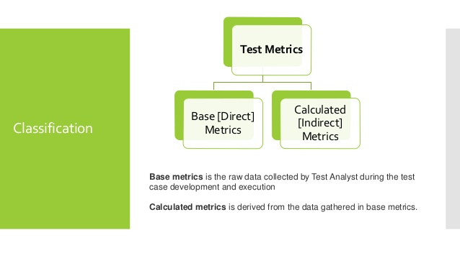
Manual Test Metrics

Slide 15
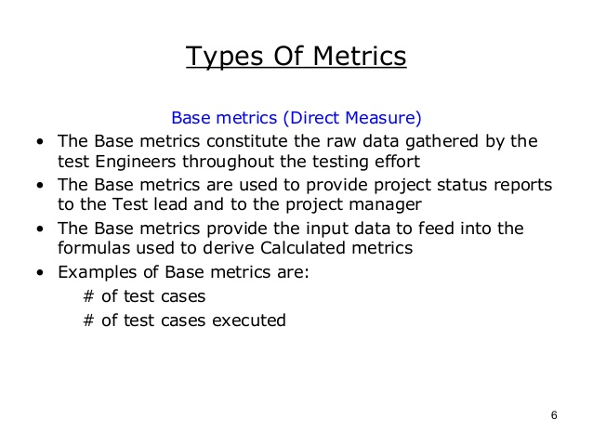

Slide 16
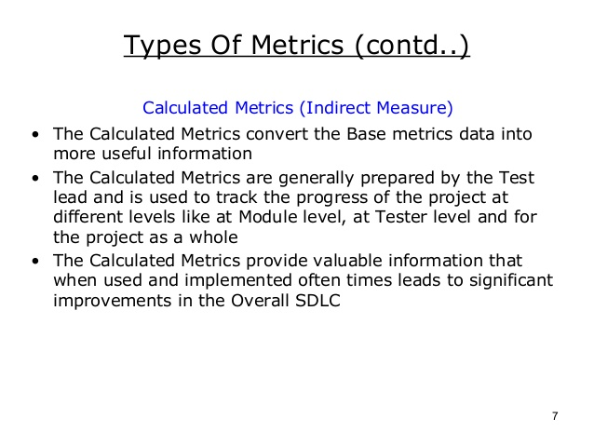

Slide 17
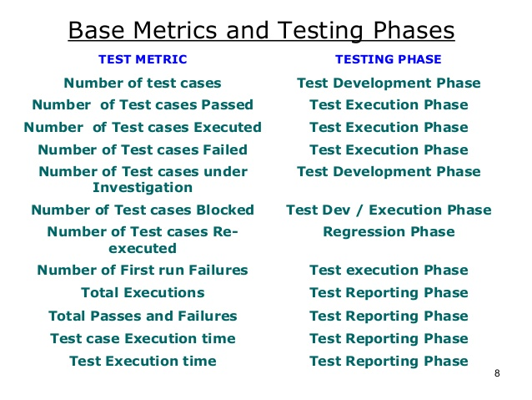

Slide 18
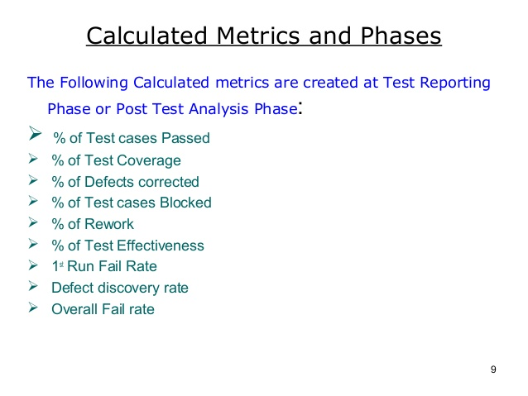

Slide 19
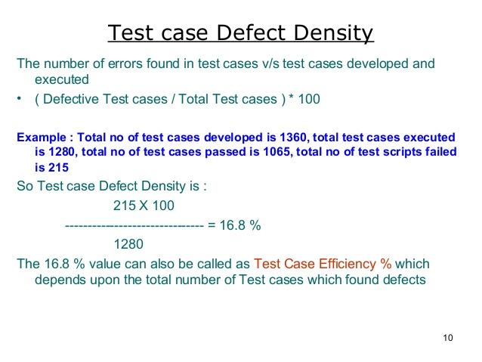

Slide 20
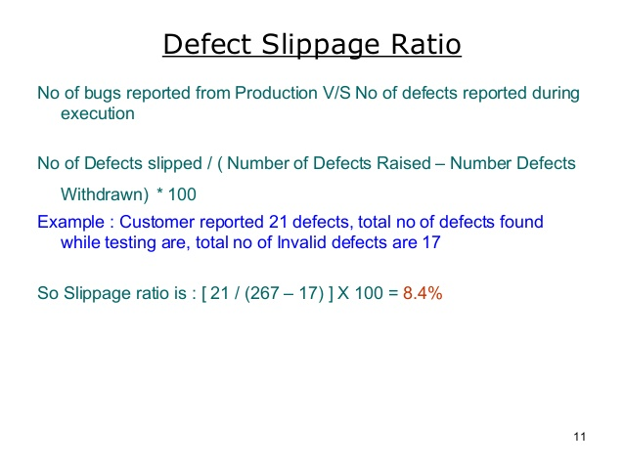

Slide 21
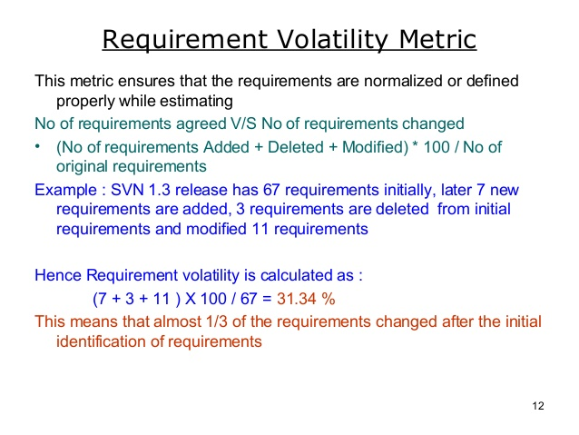

Slide 22
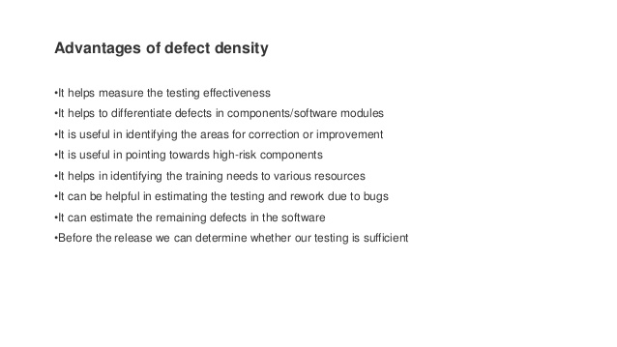

Slide 23
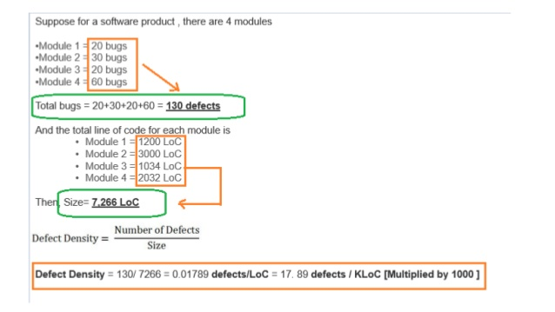

Slide 24
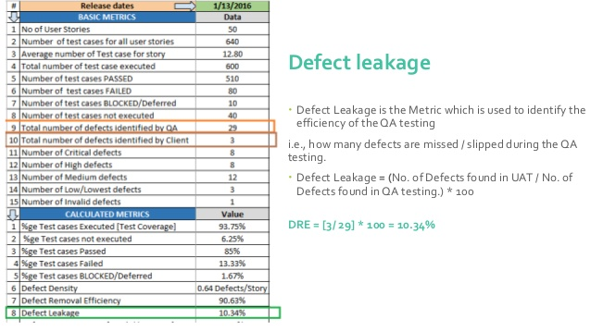

Slide 25
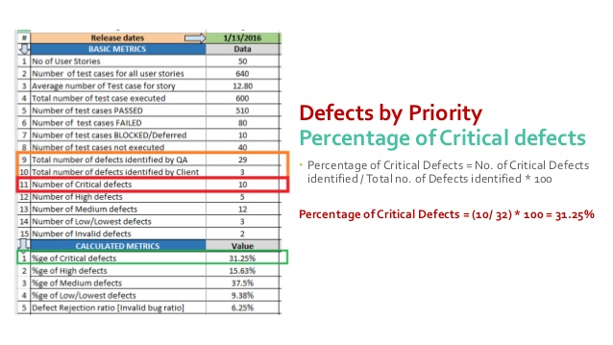

Slide 26
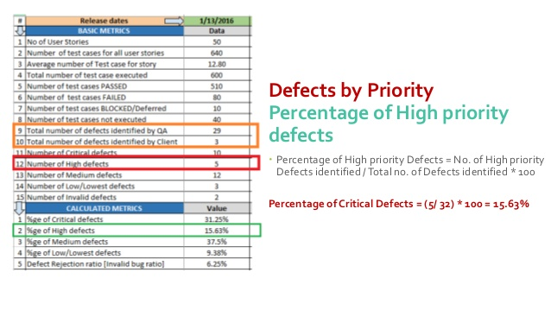

Slide 27
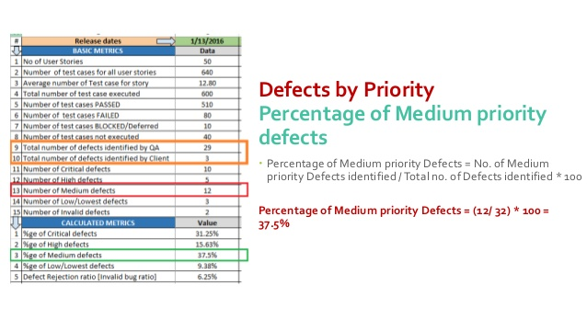

Slide 28
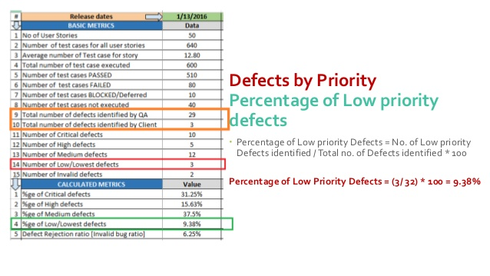

Slide 29
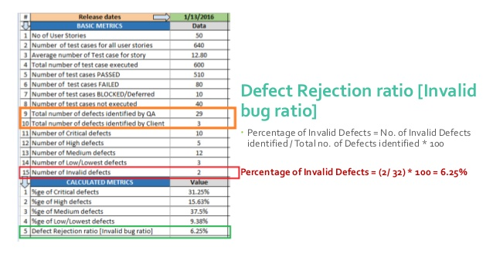

Slide 30
Test Metrics Glossary
Rework Effort Ratio = (Actual rework efforts spent in that phase/ total actual efforts spent in that phase) X 100
Requirement Creep = ( Total number of requirements added/No of initial requirements)X100
Schedule Variance = ( Actual efforts – estimated efforts ) / Estimated Efforts) X 100
Cost of finding a defect in testing = ( Total effort spent on testing/ defects found in testing)
Schedule slippage = (Actual end date – Estimated end date) / (Planned End Date – Planned Start Date) X 100
Passed Test Cases Percentage = (Number of Passed Tests/Total number of tests executed) X 100
Failed Test Cases Percentage = (Number of Failed Tests/Total number of tests executed) X 100
Blocked Test Cases Percentage = (Number of Blocked Tests/Total number of tests executed) X 100
Fixed Defects Percentage = (Defects Fixed/Defects Reported) X 100
Accepted Defects Percentage = (Defects Accepted as Valid by Dev Team /Total Defects Reported) X 100
Defects Deferred Percentage = (Defects deferred for future releases /Total Defects Reported) X 100
Critical Defects Percentage = (Critical Defects / Total Defects Reported) X 100
Average time for a development team to repair defects = (Total time taken for bugfixes/Number of bugs)
Number of tests run per time period = Number of tests run/Total time
Test design efficiency = Number of tests designed /Total time
Test review efficiency = Number of tests reviewed /Total time
Bug find rote or Number of defects per test hour = Total number of defects/Total number of test hours

Slide 31
Release Metric
Used to determine whether the product is ready for release

